Slide 1

R语言在生态与环境科学中的应用 R language for ecologists and environmental scientists
王志恒
Zhiheng.wang@pku.edu.cn
2021.09.15 @ PKU, China
Department of Ecology
College of Urban & Environmental Sciences
Peking University

Slide 2
课程目标
掌握R语言的基础，并能在个人研究中灵活运用R语言
掌握资源环境相关学科中常用方法的R实现
实践！实践！实践！

Slide 3
课程大纲
第一讲 R语言环境简介及基本语法（1）
变量类型与定义、数据类型与结构、数据存储、数据输入与输出
第二讲 R语言环境简介及基本语法（2）
条件语句、循环语句、apply functions、编写R functions、基本做图方法
第三讲 R语言做图
第四讲 相关与回归分析及其应用（1）
相关分析、一元回归与多元回归、ANOVA、方差分解分析
第五讲 相关与回归分析及其应用（2）
广义线性模型、非线性回归
第六讲 多元统计分析及其应用（1）
PCA、SEM、线性混合效应模型
第七讲 多元统计分析及其应用（2）
分类分析、排序分析（DCA、CCA、RDA）

Slide 4
第八讲 字符串分析及应用
字符串数据分析的相关函数、网络数据的获取与清理
第九讲 空间分析及制图（1）
空间数据的类型、数据处理、空间拓扑分析、制图
第十讲 空间分析及制图（1）
常用空间统计分析方法的实现，包括spatial autocorrelation, spatial autoregression, krigging, thin plate spline (TPS)
第十一讲 宏观进化分析 (1)
DNA数据的存储、获取并处理DNA数据、DNA数据比对与建树、谱系数据的结构与存储
第十二讲 宏观进化分析 (2)
谱系结构分析、谱系多样性分析、谱系beta多样性分析、溯祖分析、谱系信号分析
第十三讲 数据随机化与生态学零模型
并行运算、数据随机化、常用零模型
第十四讲 物种分布模型及应用

Slide 5
考核方式与成绩组成
平时成绩：15分（每次1分）
课堂练习：10分/次 × 5次 = 50分
期末综合练习：35分

Slide 6

助教信息
姜峰（博士后）
手机：18845128065
E-mail：fengjiang@pku.edu.cn
微信号：jf826642210

Slide 7
R语言环境简介及基本语法
王志恒
Zhiheng.wang@pku.edu.cn
2021.09.15 @ PKU, China
Department of Ecology
College of Urban & Environmental Sciences
Peking University

Slide 8
Outline
What’s R?
Getting help in R
Variable names
Symbols & basic built-in functions
Data types and structures
Import/export data
Simple math/data summary
Make a barplot
Doing statistics: t-test
Doing statistics: ANOVA
Doing statistics: correlation and regression
Functions for basic statistics
Writing scripts

Slide 9
What’s R
Fathers of R: Ross Ihaka and Robert Gentleman (R&R) from Univ. Auckland
First release: 1995
Open source: completely free of charge and available under the GNU public license
R language: S
Commercial counterpart: S-PLUS
R is named partly after the first names of the first two R authors and partly as a play on the name of S.

Slide 10
What’s R
R Development Core Team
Douglas Bates
John Chambers
Peter Dalgaard
Robert Gentleman
Kurt Hornik
Ross Ihaka
Tomas Kalibera
Michael Lawrence
Friedrich Leisch
Uwe Ligges
Thomas Lumley
Martin Maechler
Martin Morgan
Paul Murrell
Martyn Plummer
Brian Ripley
Deepayan Sarkar
Duncan Temple Lang
Luke Tierney
Simon Urbanek

Slide 11
What’s R
A functional and object-oriented programming language
An environment for statistical computing
Powerful graphics system
An open-source implementation of the S programming language
Available under all major operating systems including versions of Windows, MacIntosh, UNIX and Linux, as well as their command prompt (e.g., DOS window).

Slide 12
What’s R
Current version: v4.1.1
Packages: currently 18186 available packages, 10282 are developed since Jan 1, 2020
ape – phylogenetic analyses
vegan – community analyses

Slide 13
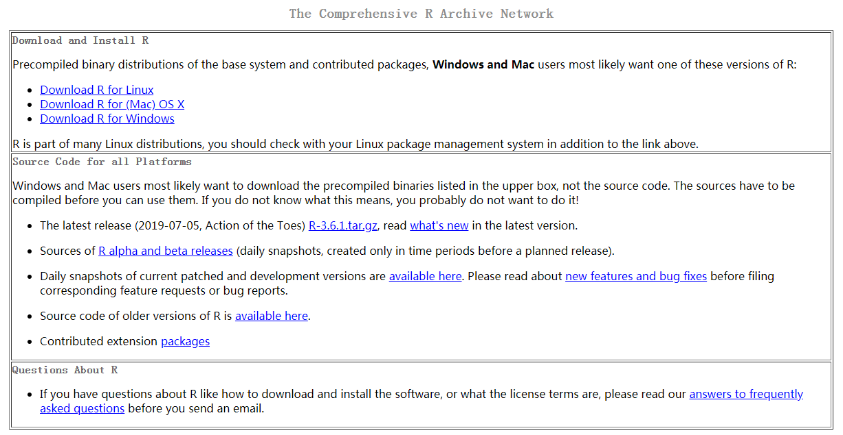
R软件安装
下载地址：https://cran.r-project.org/

Slide 14
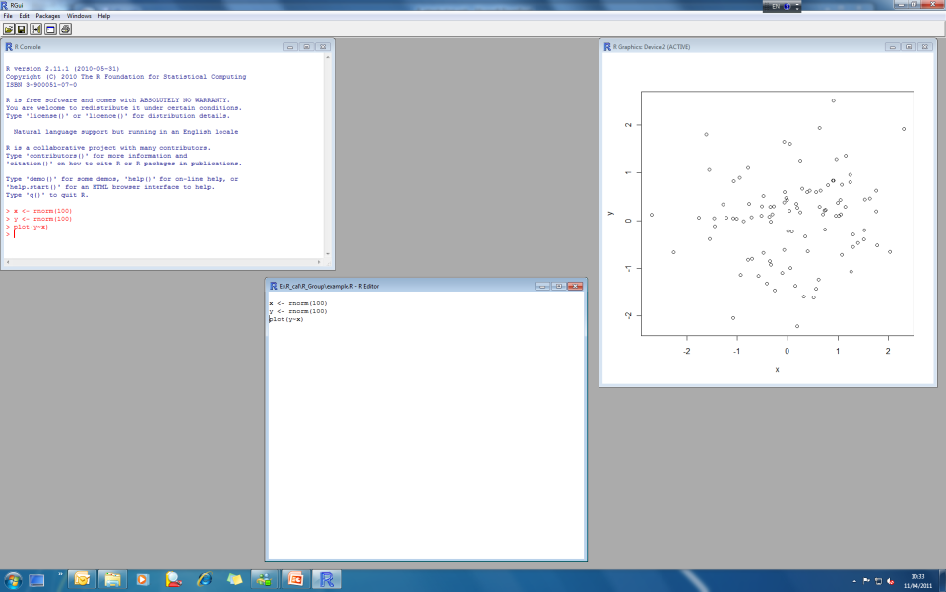
R软件界面
Download: http://www.r-project.org/
Supporting Linux, Mac and Windows
Console
Graphic window
Script window

Slide 15
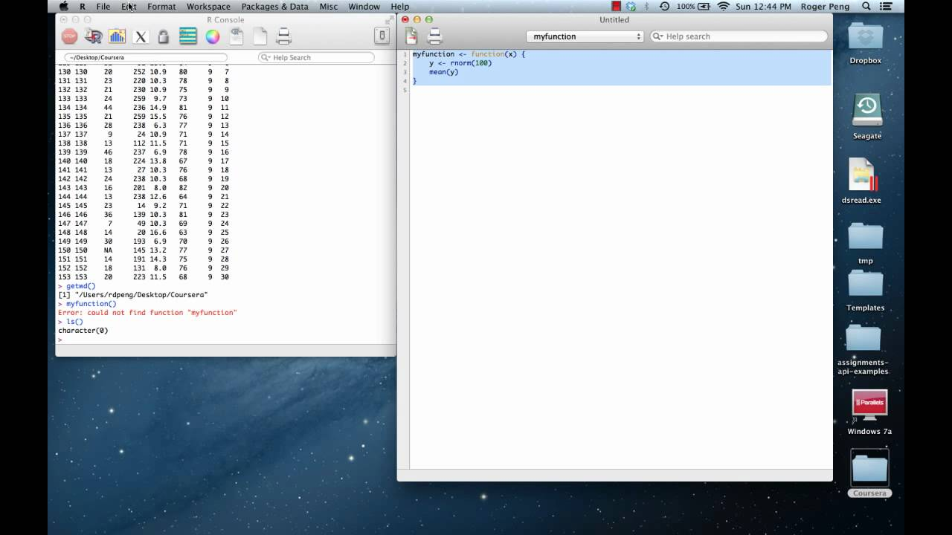
R软件界面

Slide 16
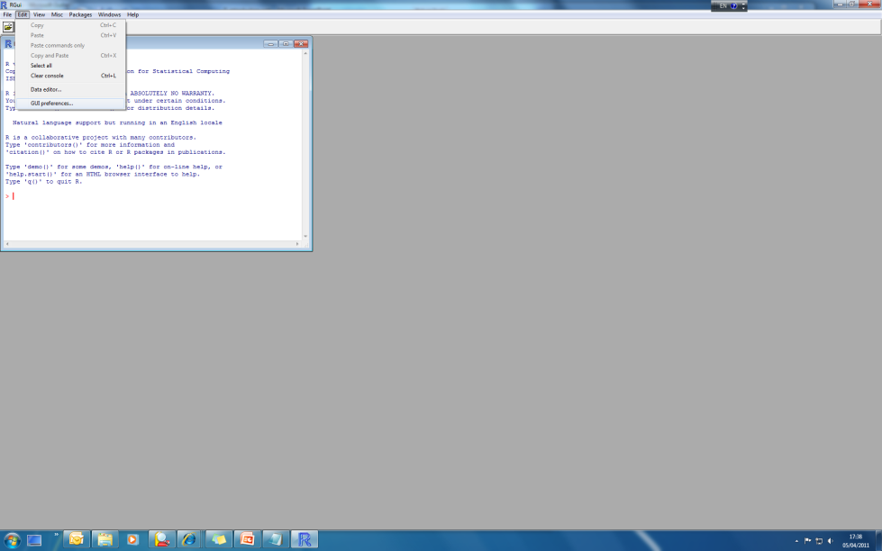
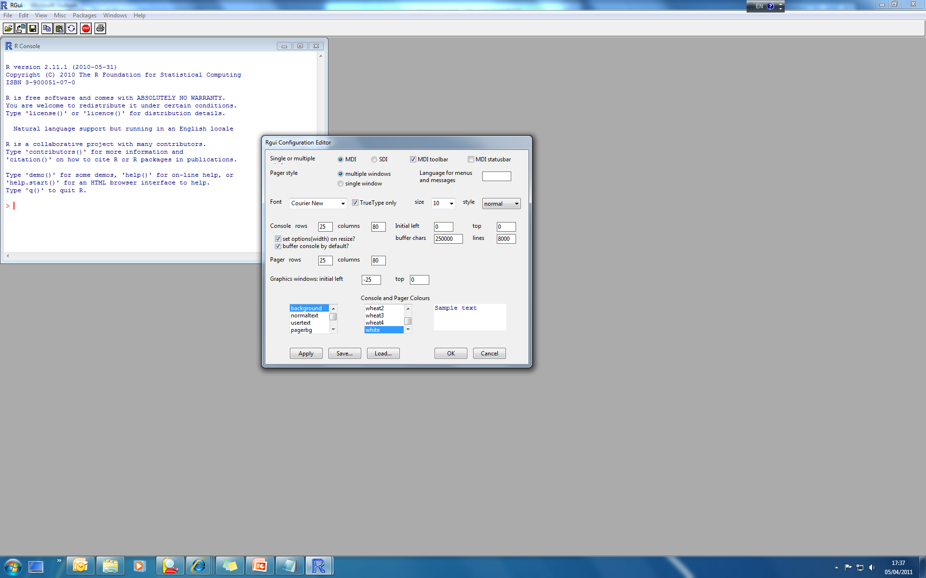
R软件界面设置
Change the interface to your preference
Edit -> GUI preference
Language
Font and size
Color of texts

Slide 17
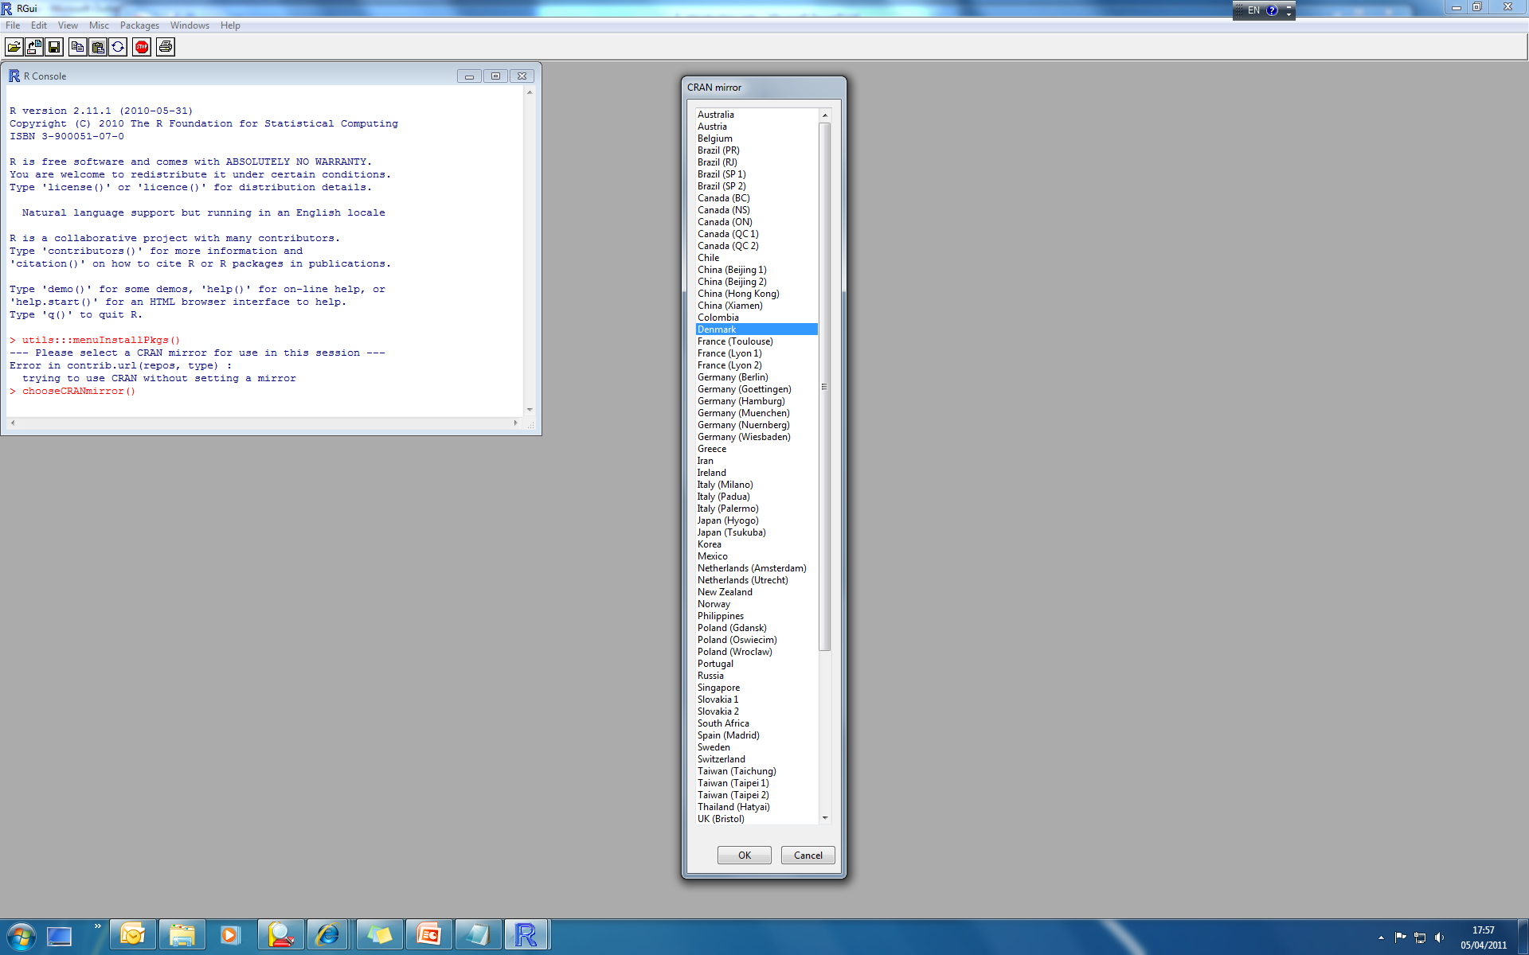
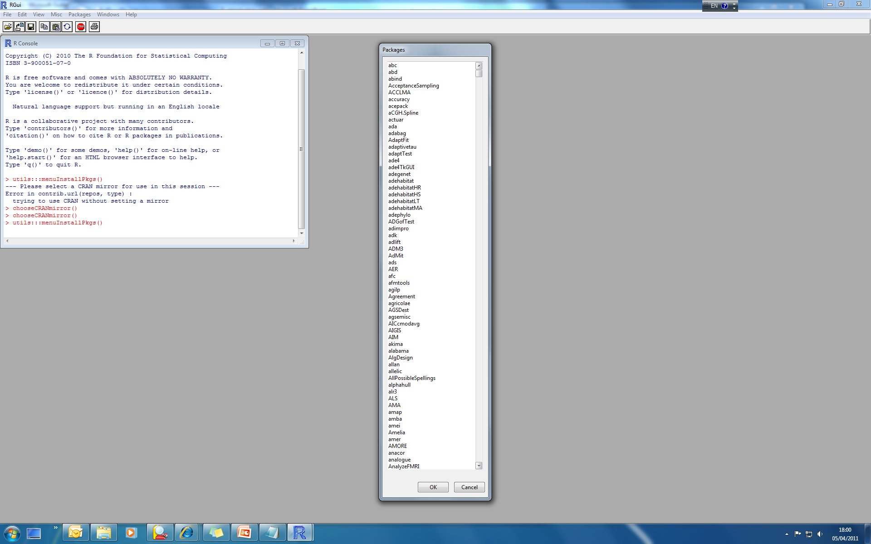
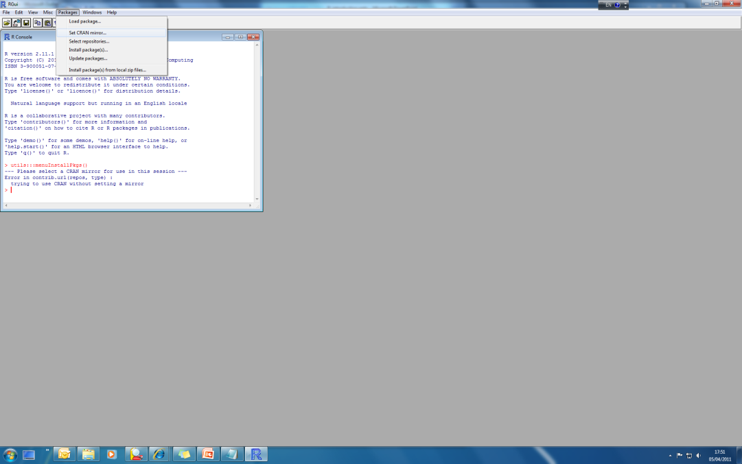
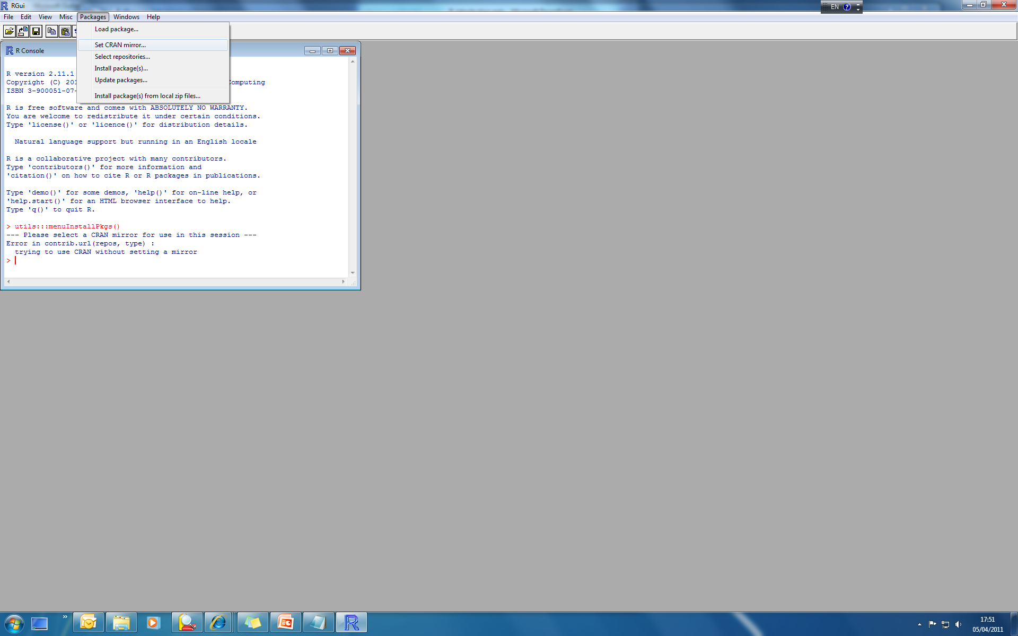
安装package
Mirrors
Packages
1) Packages -> Set CRAN mirror
2) Package -> Install package(s)
> install.packages(”package name")
Load packages
library(“package name”) or require(“package name”)
> library(“ape”)
> require(“vegan”)

Slide 18
Useful software companied with R
Rstudio
http://www.rstudio.com/
Tinn-R
http://sciviews.org/Tinn-R/
Revolution-R
http://www.revolutionanalytics.com/
Emacs & ESS
http://www.revolutionanalytics.com/
Notepad++ & NppToR
http://www.revolutionanalytics.com/

Slide 19
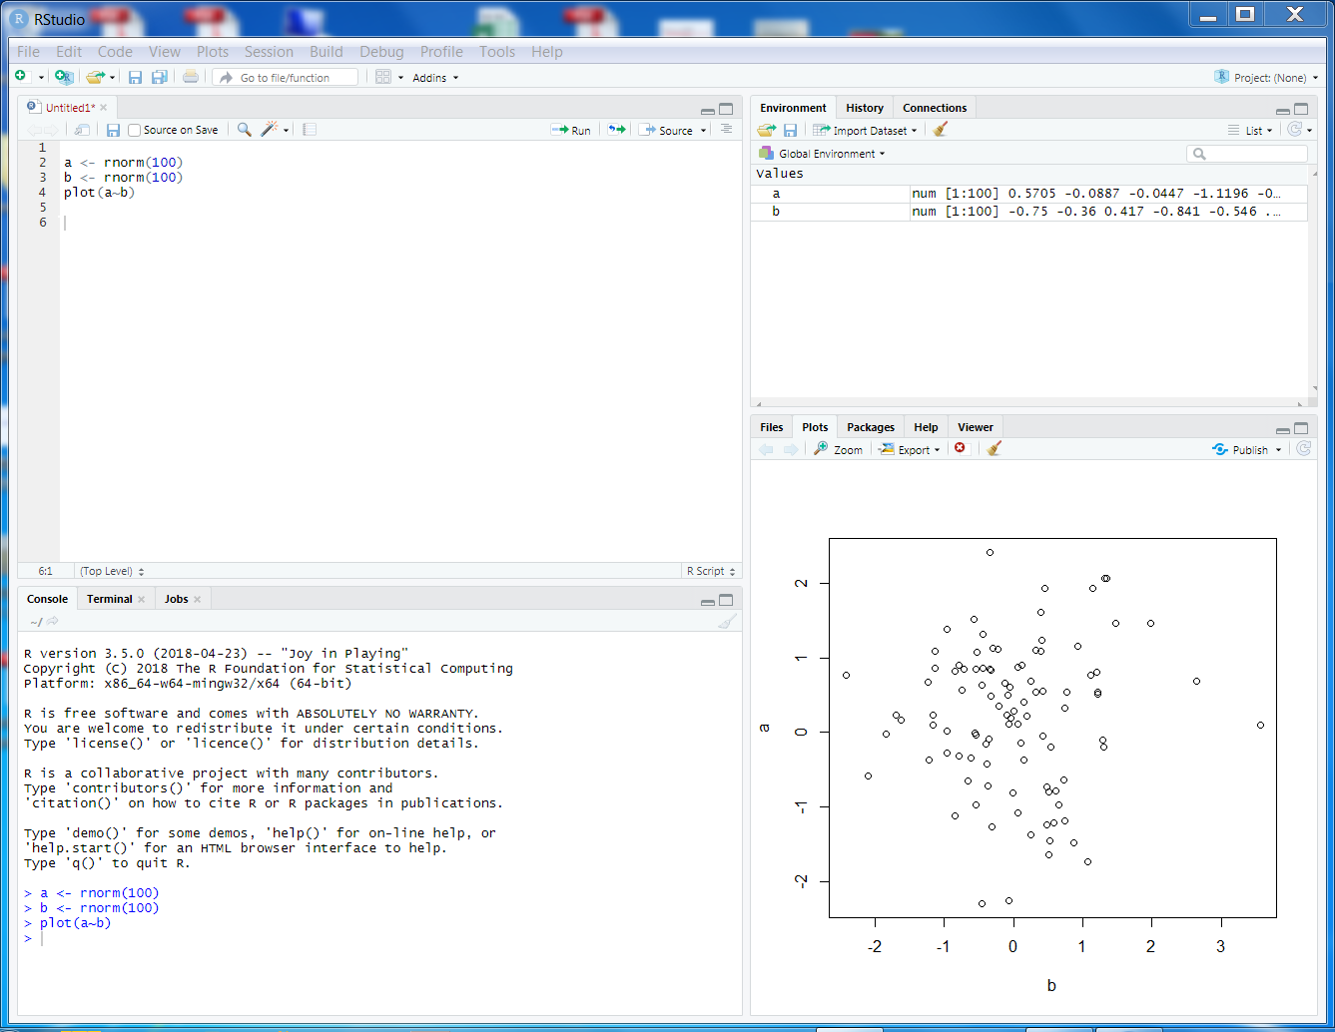
R软件安装
RStudio是为R语言设计的一种跨平台集成开发环境，有免费版本及收费专业版本，桌面版和服务器版（可由浏览器连接后使用）。RStudio主要基于Java、C++以及少量的JavaScript，而它的图形用户界面则基于Qt。最新版本为1.4。

Slide 20

R软件安装

Slide 21
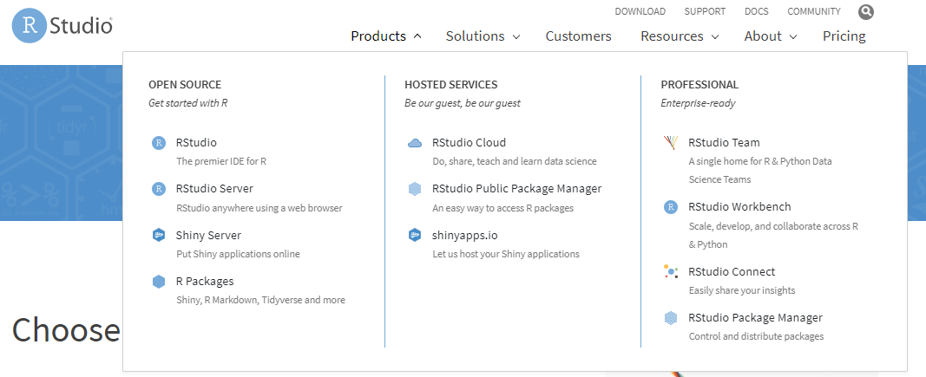

R软件安装

Slide 22
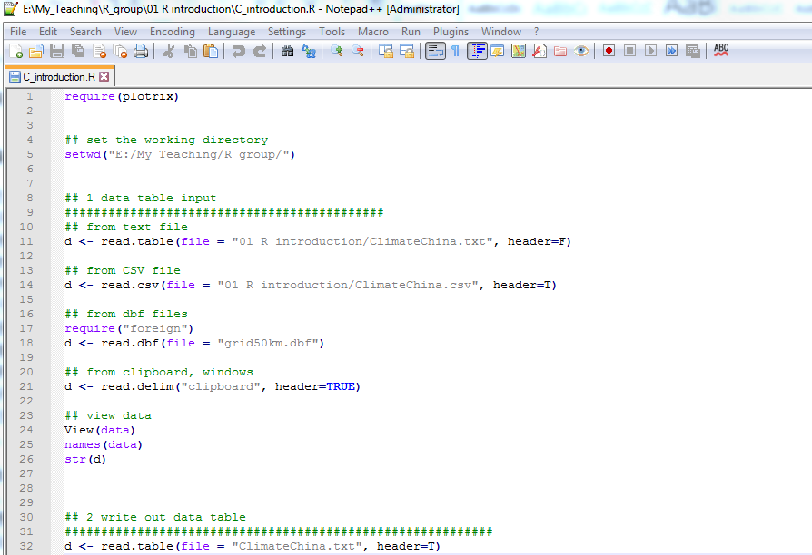
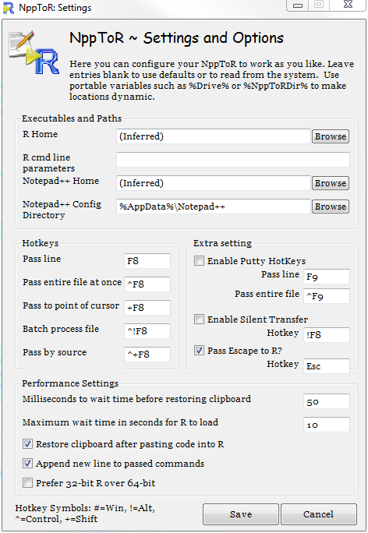
R代码编辑软件
Notepad++
NppToR

Slide 23
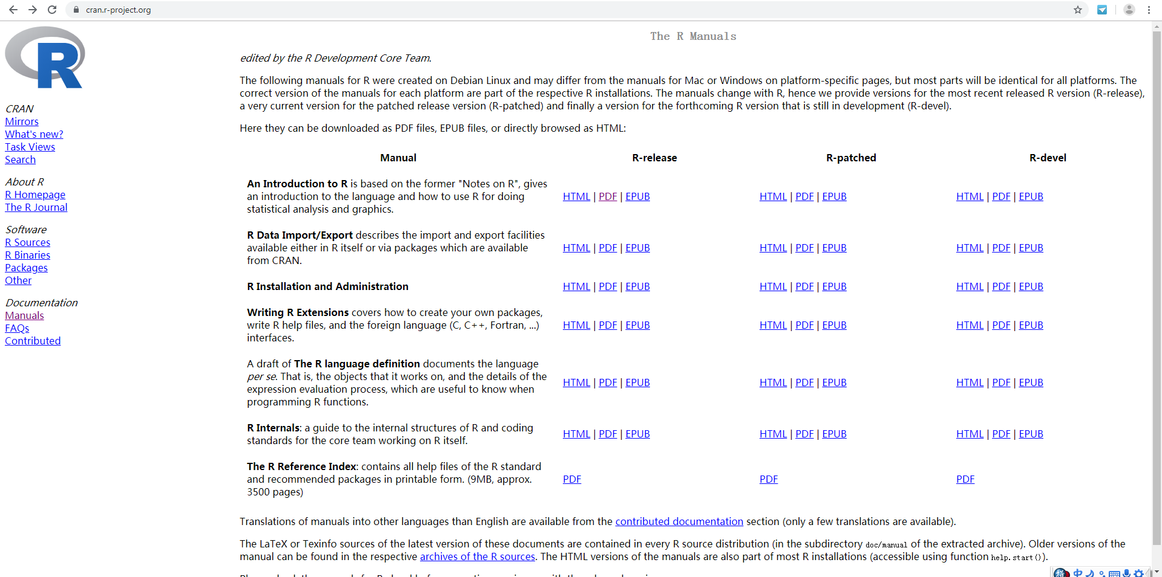
R工具书

Slide 24
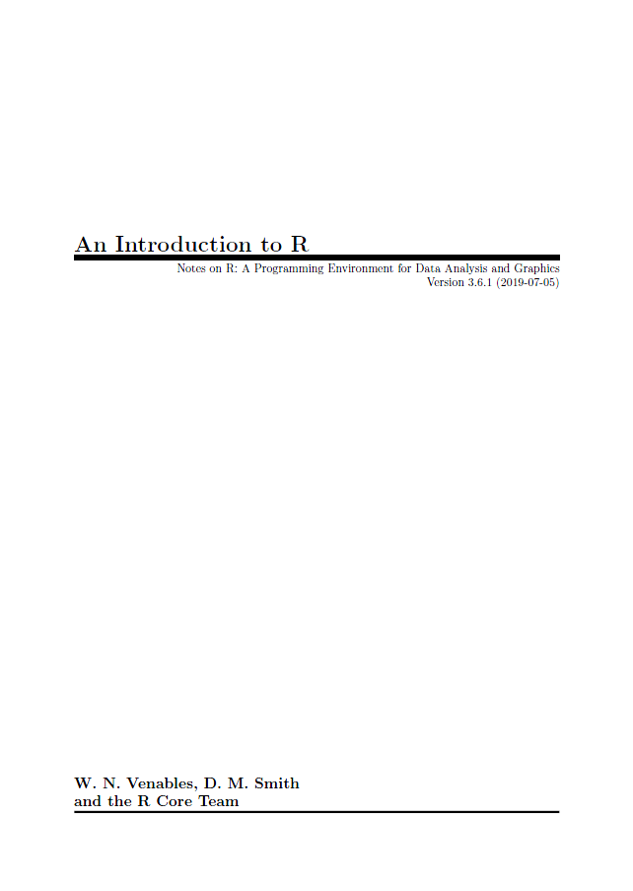
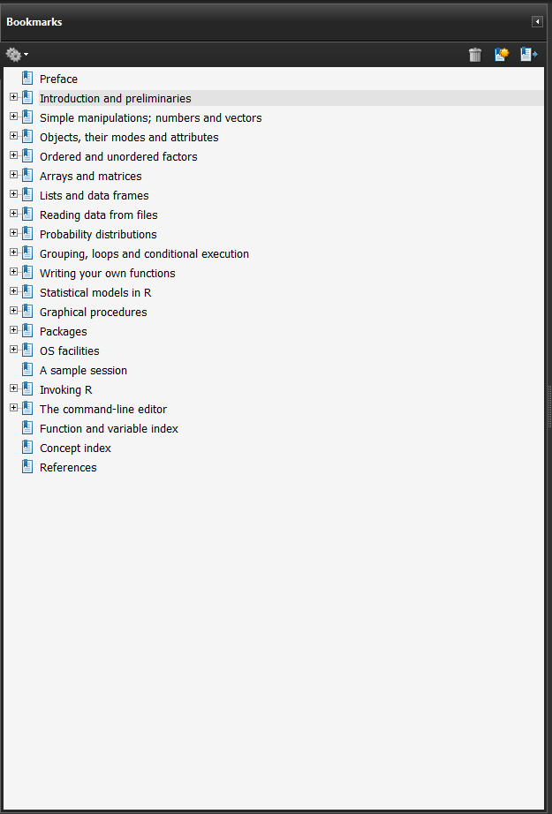

Slide 25
R工具书

Slide 26
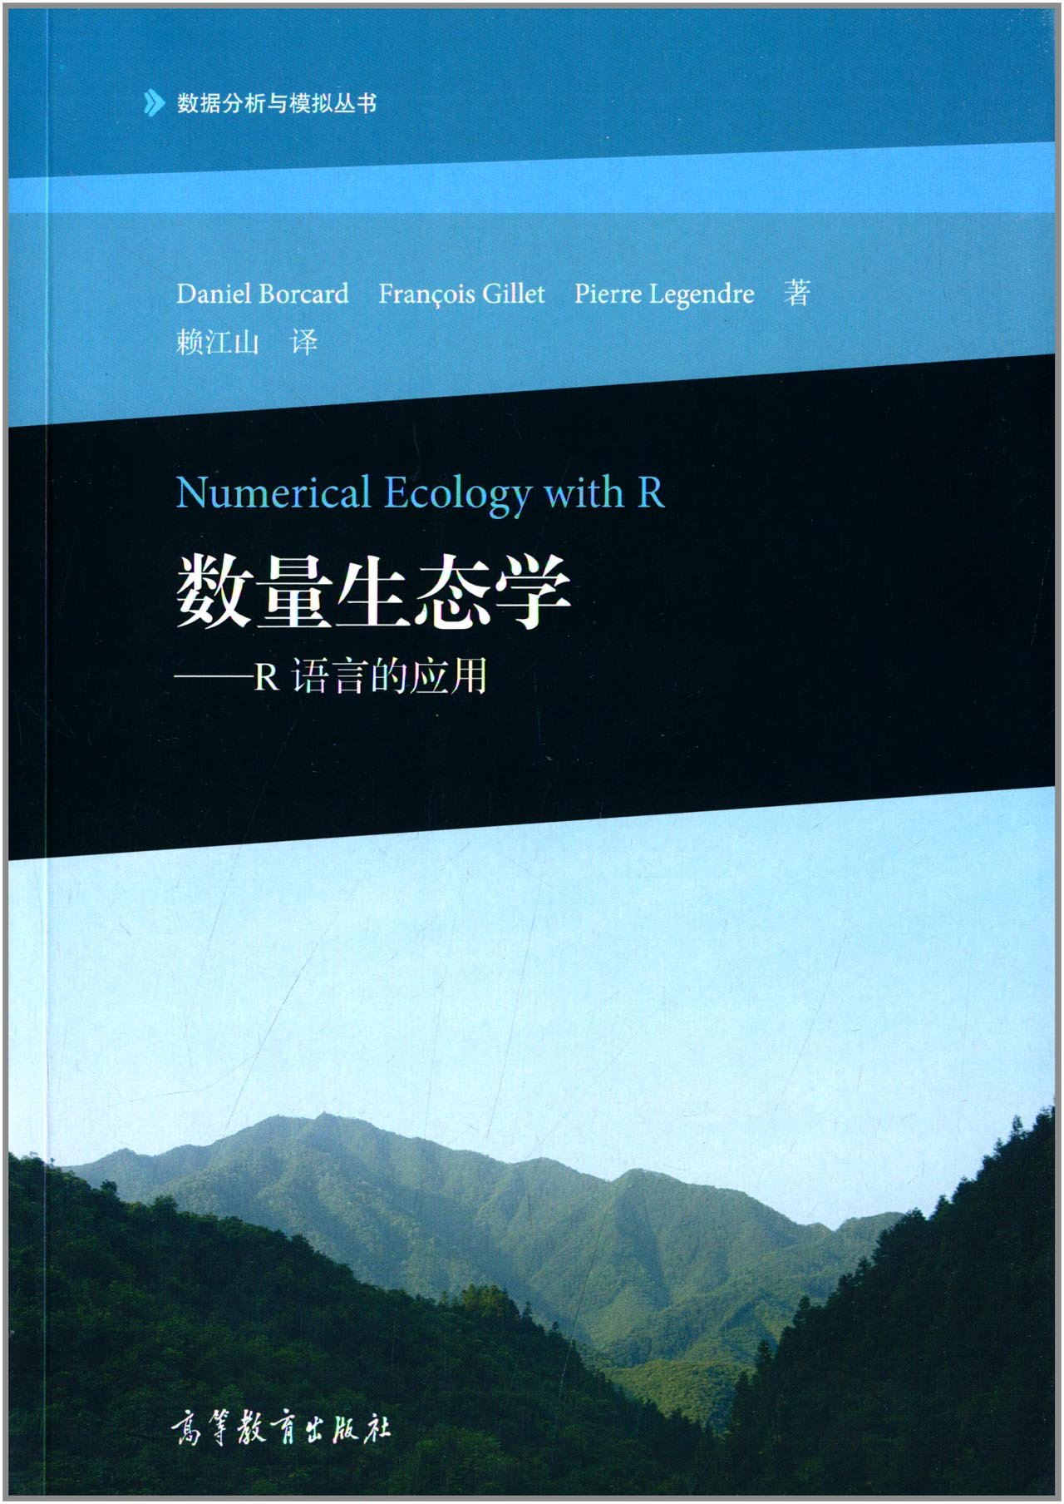
R工具书

Slide 27
Using R interactively
Default Prompt - shown when R is expecting input commands
>
Continuation Prompt – shown when R is expecting further input for a not-yet complete command
+
Pressing <Enter> sends a command to the R engine for evaluation
Use the up and down arrow keys to navigate through a history of commands

Slide 28
Arithmetic
Default Prompt
> 100 ^ 100 ^ 100
[1] Inf
> 5 / 0
[1] Inf
> -5 / 0
[1] -Inf
> 0 / 0
[1] NaN
> (-5) ^ (1/2)
[1] NaN
> 5 * 7 + 2 1
Error: unexpected numeric constant in "5 * 7 + 2 1"
> 5 * 7 + 2
[1] 37
> 5 * (7 + 2)
[1] 45
> 5 *
+ (7 + 2)
[1] 45
Continuation Prompt
Note: Spaces and carriage returns in R expressions are ignored, as long as they are not in the middle of numbers or names.

Slide 29
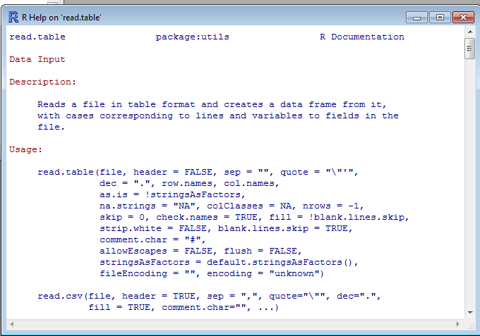
How to get help in R?
1) If you know the functions: ?
e.g.
> ?read.table
> ?lm
> help(“mean”)
2) If you know a part of the function name: apropos()
e.g.
> apropos(“cor”)
> apropos(“lm”)
[1] ".__C__recordedplot" "cancor" "cor"
[4] "cor.test" "cov2cor" "Harman23.cor"
[7] "Harman74.cor" "recordGraphics" "recordPlot"

Slide 30
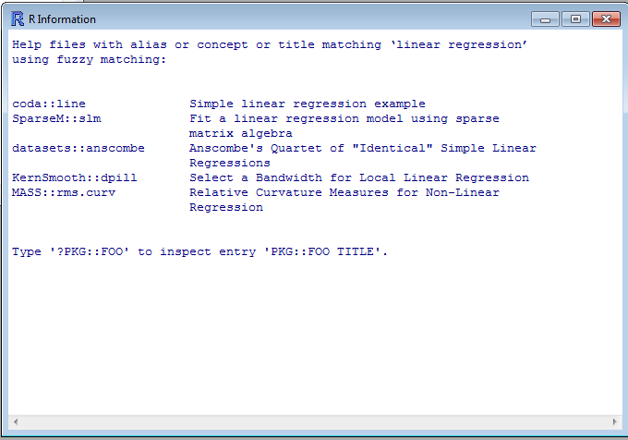
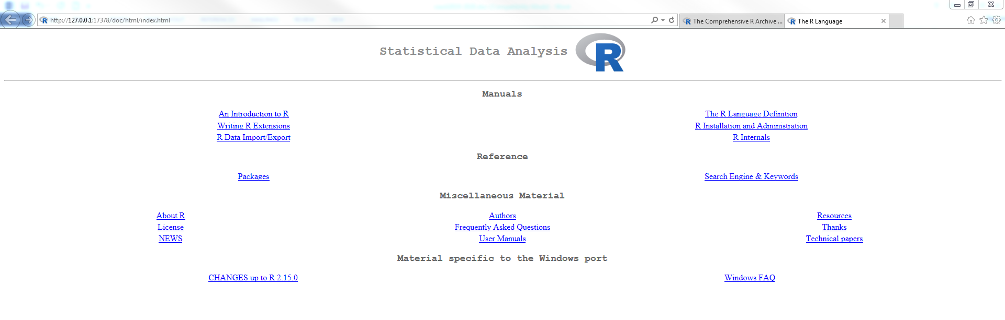
How to get help in R?
3) If you don’t know the functions: ?? or help.search()
e.g.
> ??read.table
> ??lm
> ??”linear regression”
> help.search(”linear regression”)
4) help.start()

Slide 31
What Are Objects in R?
A single entity in R is called an “object”
Objects store information ranging from data values to R language commands and functions
Everything in R is considered to be an object: Data, commands, functions, operators, graphs
Objects storing data for a typical data analysis include:
Vectors
Matrices
Data frames
Lists

Slide 32
Data Object Examples ...
The simplest R object type is a vector, which is an ordered sequence of values:
[1] 9.6 12.9 9.9 8.7 6.8 12.5 13.0 10.1
Note: In R, even single values (scalars) are vectors (of length one).
Vectors may also contain categorical or character data:
[1] 10pm 6am 6pm 10am 2am 10pm 2pm 2pm
[9] 10pm 2am 10am 6pm 6pm 10pm 10am
When long vectors are printed, the brackets, [], contain the index to the first value in each row of the printout.
A matrix is a vector with a rectangular structure imposed on it:
[,1] [,2] [,3]
[1,] 9.6 16.2 9.5
[2,] 12.9 14.1 16.5
[3,] 9.9 10.6 9.3
Note: For a matrix, the brackets indicate rows and columns. For example, [2,] indicates the 2nd row, and [,3] indicates the 3rd column.

Slide 33
Function Objects
Actions in R are performed by functions.
User input to functions are provided through arguments.
Functions are executed by typing the function name, followed by comma-separated arguments enclosed in parentheses:
> mean( rivers, trim = 0.1 )
[1] 490.9469
> lm( circumference ~ age, data = Orange )
Call:
lm(formula = circumference ~ age, data = Orange)
Coefficients:
(Intercept) age
17.3997 0.1068

Slide 34
Let’s staRt!
Basic structure:
name <- variable / function(x, parameter, …)
name = variable / function(x)
variable / function(x) -> name
Assign values
Print on screen
Variable <- value
Value -> variable
Variable = value
Type the variable name and enter
> var1
[1] 2.5
> var1 <- 2.5
> c(2.5, 3, 6) -> var2
> var3 = 1:10

Slide 35

How to define a variable name?
For object names, normally all alphanumeric symbols are allowed plus ‘.’ and ‘_’, with the restriction that a name must start with ‘.’ or a letter, and if it starts with ‘.’ the second character must not be a digit.
Important: Names are case sensitive.
1 Composed of letters, numbers and specific symbols (i.e. “.” and “_”)
var,1 var%1 var_1
var-1 var’1 var.1
2 Case sensitive
VAR.1 ≠ var.1
3 Start with letters or dot
1var .var1
4 No spaces
var 1 var.1

Slide 36
How to define a variable name?
Examples of valid names:
Survey.2 diastolic.blood.pressure r.2.d.2 ._clone
data.from.professor.Smiths.dog.on.the.day.of.its.untimely.death
Examples of invalid names:
2.b.or.not.2.b _outch .2b.ornot.2b
Examples of names which are different from one another:
not.the.same NOT.THE.SAME Not.The.Same Not.the.same

Slide 37
谢谢！

